Slide 1
Programming Using the Message Passing Paradigm Ananth Grama, Anshul Gupta, George Karypis, and Vipin Kumar
To accompany the text ``Introduction to Parallel Computing'',
Addison Wesley, 2003.

Slide 2
Topic Overview
Principles of Message-Passing Programming
The Building Blocks: Send and Receive Operations
MPI: the Message Passing Interface
Topologies and Embedding
Overlapping Communication with Computation
Collective Communication and Computation Operations
Groups and Communicators

Slide 3
Principles of Message-Passing Programming
The logical view of a machine supporting the message-passing paradigm consists of p processes, each with its own exclusive address space.
Each data element must belong to one of the partitions of the space; hence, data must be explicitly partitioned and placed.
All interactions (read-only or read/write) require cooperation of two processes - the process that has the data and the process that wants to access the data.
These two constraints, while onerous, make underlying costs very explicit to the programmer.

Slide 4
Principles of Message-Passing Programming
Message-passing programs are often written using the asynchronous or loosely synchronous paradigms.
In the asynchronous paradigm, all concurrent tasks execute asynchronously.
In the loosely synchronous model, tasks or subsets of tasks synchronize to perform interactions. Between these interactions, tasks execute completely asynchronously.
Most message-passing programs are written using the single program multiple data (SPMD) model.

Slide 5
The Building Blocks: Send and Receive Operations
The prototypes of these operations are as follows:
send(void *sendbuf, int nelems, int dest)
receive(void *recvbuf, int nelems, int source)
Consider the following code segments:
P0 P1
a = 100; receive(&a, 1, 0)
send(&a, 1, 1); printf("%d\n", a);
a = 0;
The semantics of the send operation require that the value received by process P1 must be 100 as opposed to 0.
This motivates the design of the send and receive protocols.

Slide 6
Non-Buffered Blocking Message Passing Operations
A simple method for forcing send/receive semantics is for the send operation to return only when it is safe to do so.
In the non-buffered blocking send, the operation does not return until the matching receive has been encountered at the receiving process.
Idling and deadlocks are major issues with non-buffered blocking sends.
In buffered blocking sends, the sender simply copies the data into the designated buffer and returns after the copy operation has been completed. The data is copied at a buffer at the receiving end as well.
Buffering alleviates idling at the expense of copying overheads.

Slide 7
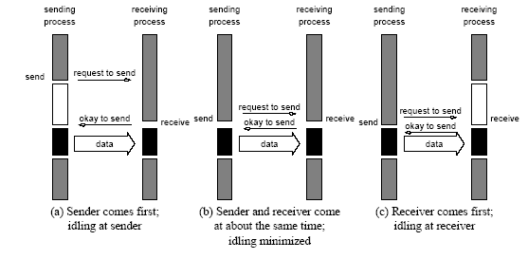
Non-Buffered Blocking Message Passing Operations
Handshake for a blocking non-buffered send/receive operation.
It is easy to see that in cases where sender and receiver do not
reach communication point at similar times, there can be considerable idling overheads.

Slide 8
Buffered Blocking Message Passing Operations
A simple solution to the idling and deadlocking problem outlined above is to rely on buffers at the sending and receiving ends.
The sender simply copies the data into the designated buffer and returns after the copy operation has been completed.
The data must be buffered at the receiving end as well.
Buffering trades off idling overhead for buffer copying overhead.

Slide 9
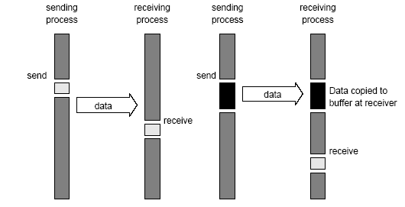
Buffered Blocking Message Passing Operations
Blocking buffered transfer protocols: (a) in the presence of
communication hardware with buffers at send and receive ends; and (b) in the absence of communication hardware, sender interrupts receiver and deposits data in buffer at receiver end.

Slide 10
Buffered Blocking Message Passing Operations
Bounded buffer sizes can have signicant impact on performance.
P0 P1
for (i = 0; i < 1000; i++){ for (i = 0; i < 1000; i++){
produce_data(&a); receive(&a, 1, 0);
send(&a, 1, 1); consume_data(&a);
} }
What if consumer was much slower than producer?

Slide 11
Buffered Blocking Message Passing Operations
Deadlocks are still possible with buffering since receive
operations block.
P0 P1
receive(&a, 1, 1); receive(&a, 1, 0);
send(&b, 1, 1); send(&b, 1, 0);

Slide 12
Non-Blocking Message Passing Operations
The programmer must ensure semantics of the send and receive.
This class of non-blocking protocols returns from the send or receive operation before it is semantically safe to do so.
Non-blocking operations are generally accompanied by a check-status operation.
When used correctly, these primitives are capable of overlapping communication overheads with useful computations.
Message passing libraries typically provide both blocking and non-blocking primitives.

Slide 13
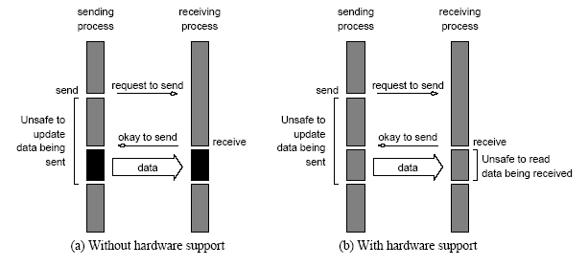
Non-Blocking Message Passing Operations
Non-blocking non-buffered send and receive operations (a) in
absence of communication hardware; (b) in presence of
communication hardware.

Slide 14
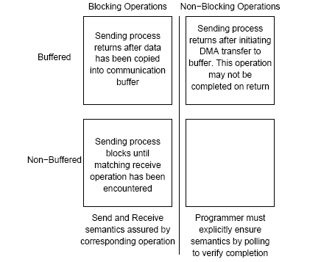
Send and Receive Protocols
Space of possible protocols for send and receive operations.

Slide 15
MPI: the Message Passing Interface
MPI defines a standard library for message-passing that can be used to develop portable message-passing programs using either C or Fortran.
The MPI standard defines both the syntax as well as the semantics of a core set of library routines.
Vendor implementations of MPI are available on almost all commercial parallel computers.
It is possible to write fully-functional message-passing programs by using only the six routines.

Slide 16
MPI: the Message Passing Interface
The minimal set of MPI routines.
MPI_Init | Initializes MPI.
MPI_Finalize | Terminates MPI.
MPI_Comm_size | Determines the number of processes.
MPI_Comm_rank | Determines the label of calling process.
MPI_Send | Sends a message.
MPI_Recv | Receives a message.

Slide 17
Starting and Terminating the MPI Library
MPI_Init is called prior to any calls to other MPI routines. Its purpose is to initialize the MPI environment.
MPI_Finalize is called at the end of the computation, and it performs various clean-up tasks to terminate the MPI environment.
The prototypes of these two functions are:
int MPI_Init(int *argc, char ***argv)
int MPI_Finalize()
MPI_Init also strips off any MPI related command-line arguments.
All MPI routines, data-types, and constants are prefixed by “MPI_”. The return code for successful completion is MPI_SUCCESS.

Slide 18
Communicators
A communicator defines a communication domain - a set of processes that are allowed to communicate with each other.
Information about communication domains is stored in variables of type MPI_Comm.
Communicators are used as arguments to all message transfer MPI routines.
A process can belong to many different (possibly overlapping) communication domains.
MPI defines a default communicator called MPI_COMM_WORLD which includes all the processes.

Slide 19
Querying Information
The MPI_Comm_size and MPI_Comm_rank functions are used to determine the number of processes and the label of the calling process, respectively.
The calling sequences of these routines are as follows:
int MPI_Comm_size(MPI_Comm comm, int *size)
int MPI_Comm_rank(MPI_Comm comm, int *rank)
The rank of a process is an integer that ranges from zero up to the size of the communicator minus one.

Slide 20
Our First MPI Program
#include <mpi.h>
main(int argc, char *argv[])
{
int npes, myrank;
MPI_Init(&argc, &argv);
MPI_Comm_size(MPI_COMM_WORLD, &npes);
MPI_Comm_rank(MPI_COMM_WORLD, &myrank);
printf("From process %d out of %d, Hello World!\n",
myrank, npes);
MPI_Finalize();
}

